Slide 1
Sprint Competitions
Individual sprint / Team sprint
ICR 360.x / ICR 361.x
Uroš Ponikvar (SLO)

Slide 2
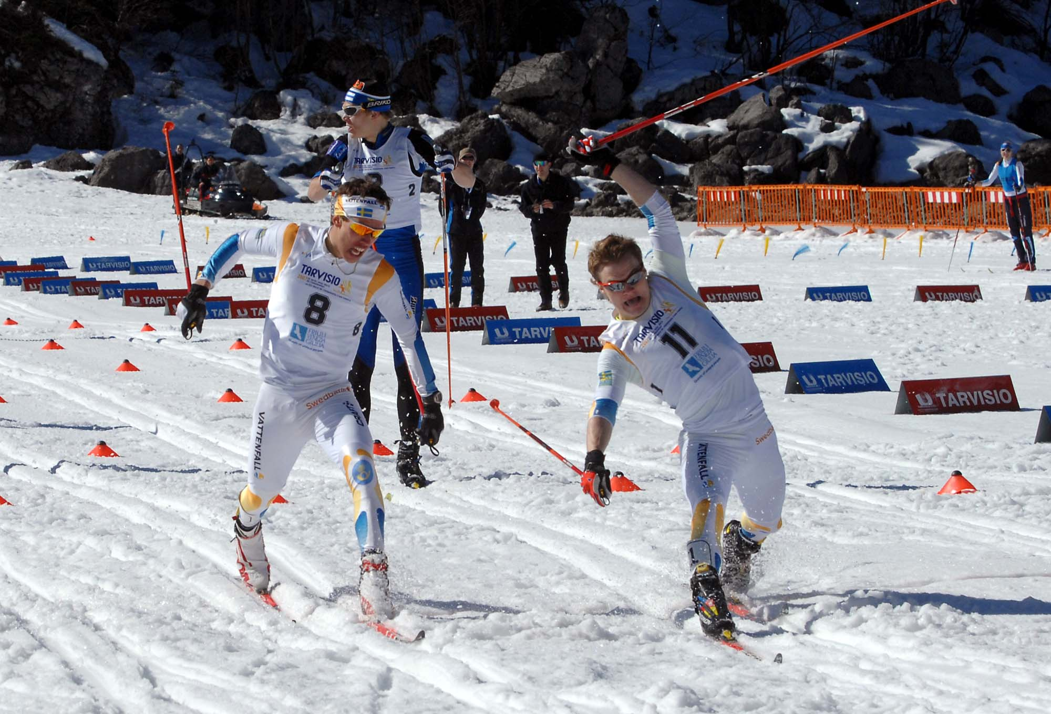
Question from WC Düsseldorf 2007

Slide 3
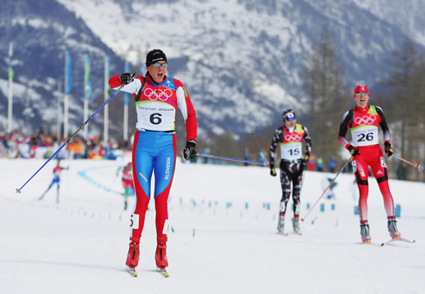
Individual Sprints
ICR 360.x
Qualification
2nd Team Captains Meeting
Final Sprint Heats
  ¼ Finals
  ½ Finals
  Finals (B) A
Can be reduced
@ FIS level competitions

Slide 4
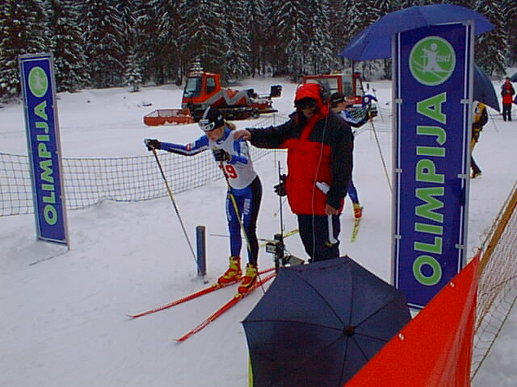
Qualification
Individual start
Shorter interval /15”, 20” ICR 360.2.2
Start list composition ICR 360.2.1
  Sprint PTS
  Distance Pts
  No Pts: Draw
NO ski marking ICR 342.1.3
Tie for Rk 30 (24, 16) ICR 360.2.5
Timing precision 1/1000 → Publish in 1/100
Protests ICR 393
ICR 393.4
2 laps → Block Start

Slide 5
Block Start Examples I
Start interval 15’
Lap Time ~ 0.55 -1.05 |  | Lap Time ~ 1.10 -1.20
Bib No. | Start time | Bib No. | Start time
1 2 3 4 | 0.00 0.15 0.30 0.45 | 1 2 3 4 5 | 0.00 0.15 0.30 0.45 1.00
5 6 7 8 | 2.00 2.15 2.30 2.45 | 6 7 8 9 10 | 3.00 3.15 3.30 3.45 4.00
9 10 11 12 | 4.00 4.15 4.30 4.45 | 11 12 13 14 15 | 6.00 6.15 6.30 6.45

Slide 6
Block Start Examples II
Lap Time ~ 0.40 -0.50 |  | Lap Time ~ 1.25 -1.35
Bib No. | Start time | Bib No. | Start time
1 2 3 4 | 0.00 0.10 0.20 0.30 | 1 2 3 4 5 6 | 0.00 0.15 0.30 0.45 1.00 1.45
5 6 7 8 | 2.00 2.10 2.20 2.30 | 7 8 9 10 11 12 | 3.00 3.15 3.30 3.45 4.00 4.15
9 10 11 12 | 4.00 4.10 4.20 4.30 | 13 14 15 16 17 18 | 6.00 6.15 6.30 6.45 7.00 7.15

Slide 7
Second Team Captains Meeting
Qualified Nations Only
Best Practices
  Just Bib/start List / Leg bib distribution

Slide 8

TD Checklist
Actual FIS Lists: Distance and Sprint
Bib numbers
  Qualification
  Heat Sprints (now 1-30)!
  Leg bibs
Official Info Board
Video Control
FF Camera / Video Control
Dictaphone? Excel

Slide 9
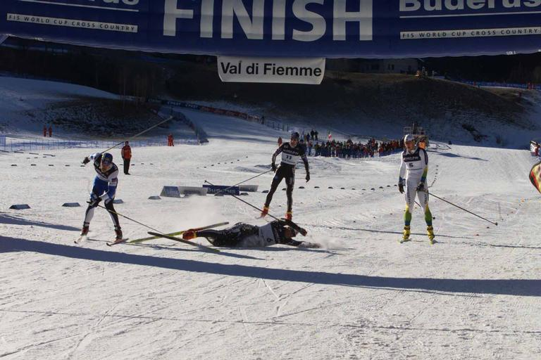
Heat Sprints
Qualification is the easy part
Heat Sprint System 2008/09
  ¼ Finals: 5 Heats with 6 athletes
  ½ Finals: 2 Heats with 6 athletes
  B Final: 1 Heat with 6 athletes
  A Final: 1 Heat with 6 athletes
World Cup / WSC
  2 Best in each heat advance +
  2 fastest “Lucky Loosers”
COC / FIS
  Quarter Finals
    2 best in each heat advance +
    2 lowers bib numbers* among 3rd
    ranked in heats
  Semi Finals
    3 best in each semi finals advance
  * =Qualification Time
TD has to follow the heats
(somtimes organizers get lost!)

Slide 10
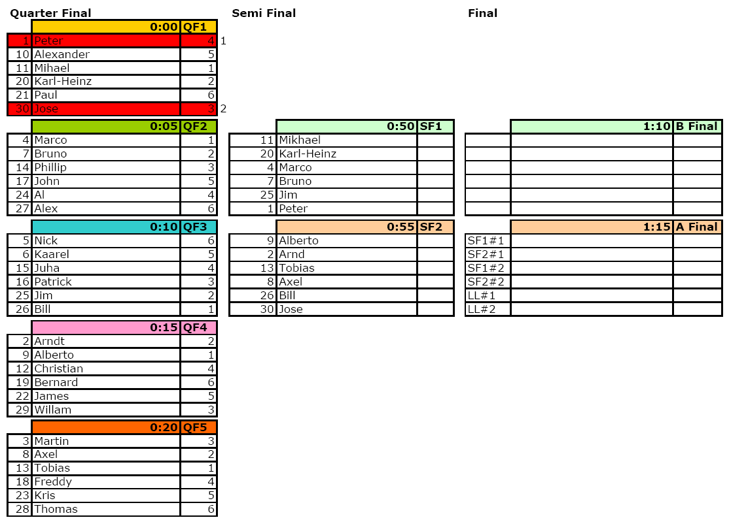
Heat Sprints Examples:
WC ¼ Finals

Slide 11
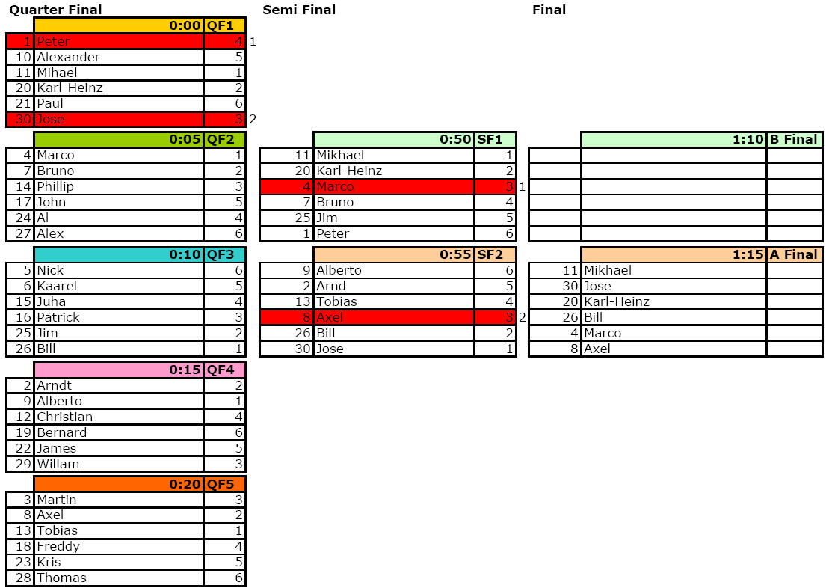
Heat Sprints Examples:
WC ½ Finals

Slide 12
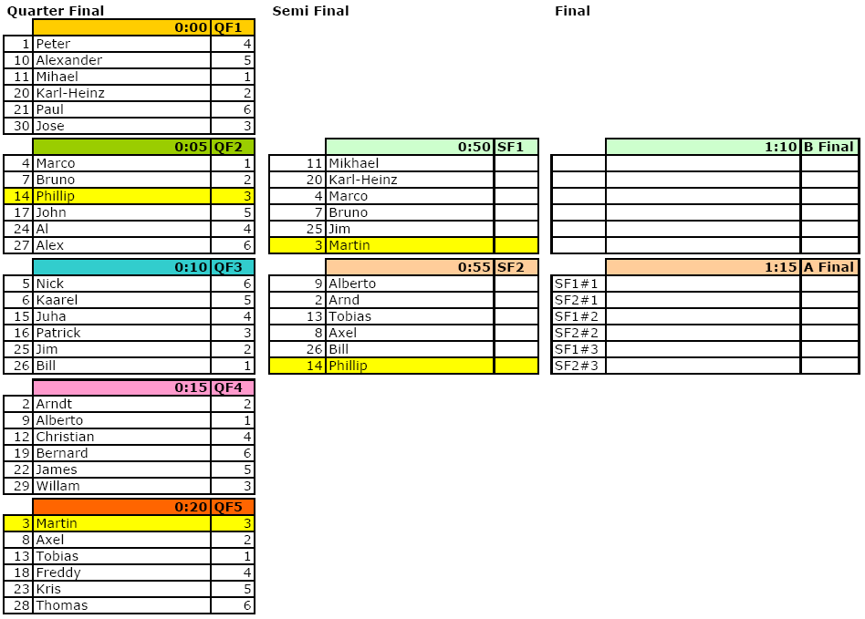
Heat Sprints Examples:
COC ¼ Finals

Slide 13
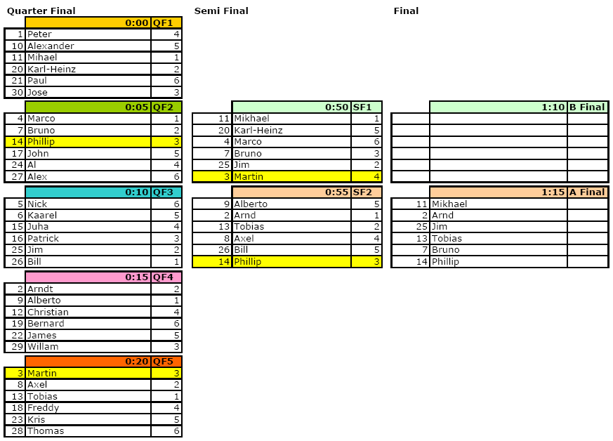
Heat Sprints Examples:
COC ½ Finals

Slide 14
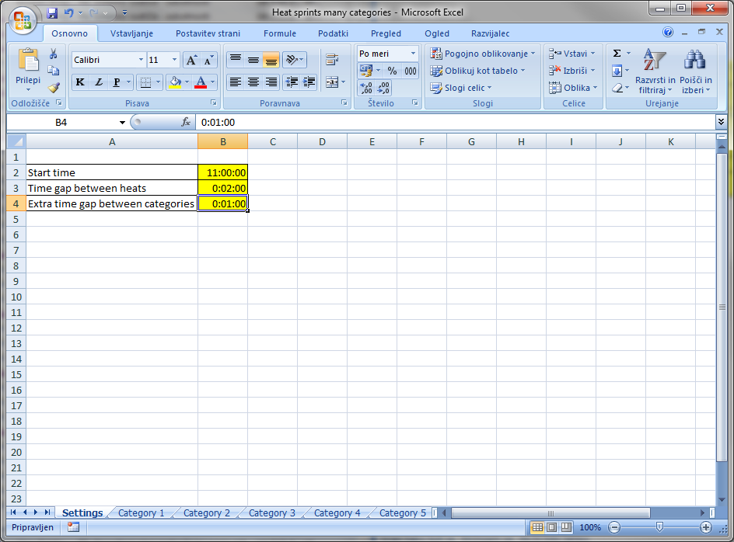
Time factor in heats
In case of delay…
Better take one minute to get in control

Slide 15
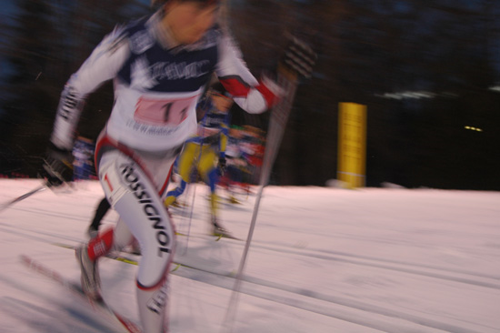
Starts in heat sprints
ICR 360.3.6.1 – 360.3.6.3
Start Positions
Start Gates
Classical track (C and F races!) first 10 m
Position of qualification track
Start Command
  Take your start positions
  SET – motionless!!!
  Start signal
False Start Procedure
  Put offender to the last place in
  AF/SF/QF
  More than one offender

Slide 16
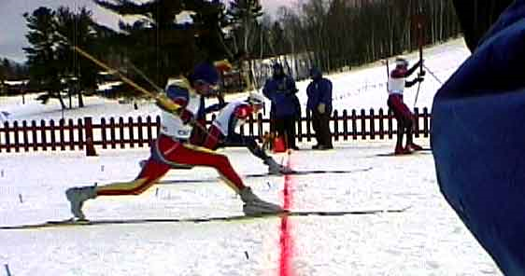
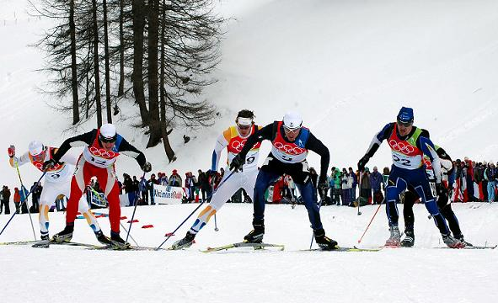
What Can Happen During Heat Sprints?
(NO)Protests ICR 360.6.1 / 360.7.1
False Starts
Obstructions ICR 340.1.4 | ICR 392.5
ICR 360.3.9 (DSQ)
ICR 360.3.10 (WR)
Second written reprimand?
Dead Heat ICR 360.3.5
ICR 314.1.1 Violations ICR 392.4
DNF ICR 360.3.7
ICR 360.3.8

Slide 17
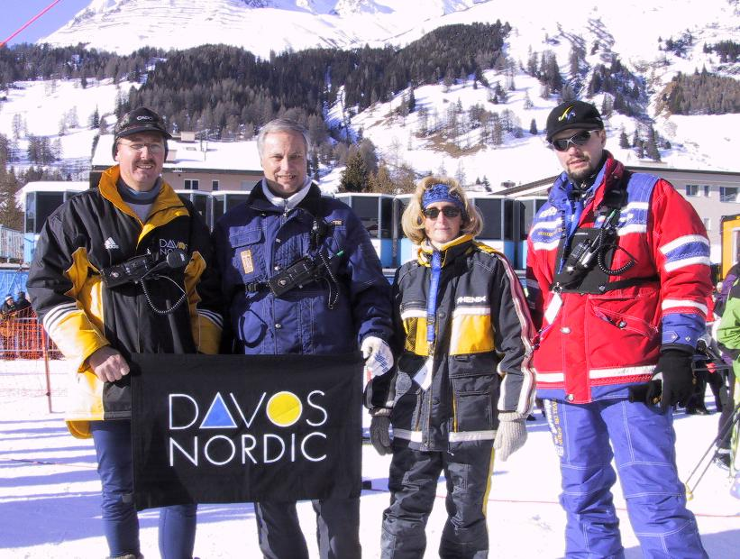
Jury Work
ICR 360.6.1
Unanimous decision of 3 jury members incl. TD (WC only)
Tasks
  Start
  Finish (FF)
  Video
  Other
React
  314.1.1 (Classic)
  Obstructions
  Unusual cases

Slide 18
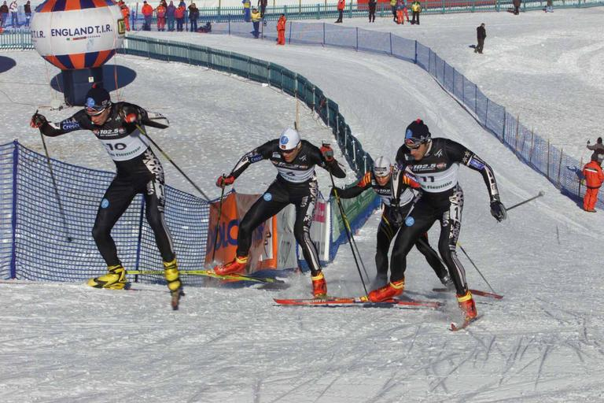
Course & Stadium Requirements
ICR 360.4.x
Start
  Classical Technique: 9 m
  Free Technique: 18 m (classical track!)
Course width
  Classical Technique Category C Uphill 6 m
  Free Technique Category D Uphill 9 m
  Use of Corridors Don’t
Finish
  4 Corridors

Slide 19
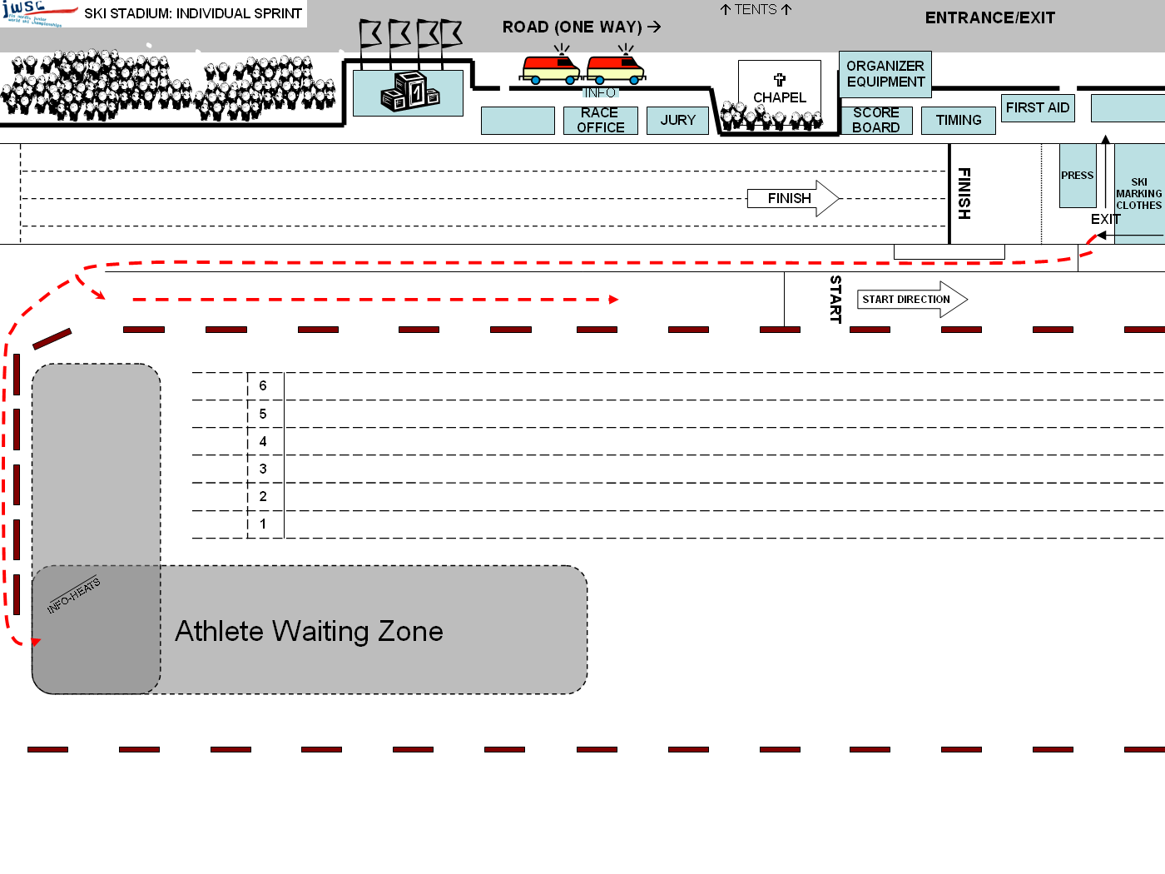

Slide 20
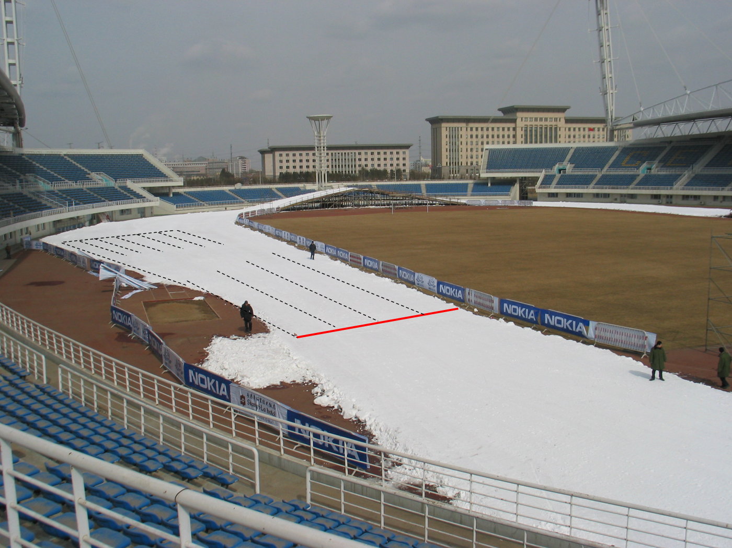

Slide 21
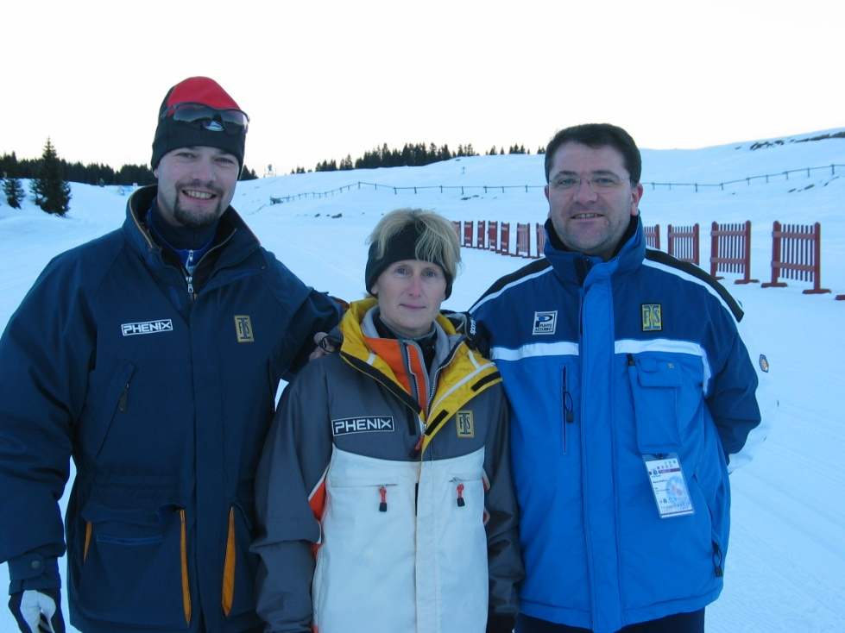
Challenges for the TD
Plan
Prepare
Try to Predict
Curves
Jury must react if something happens
ICR 224 (Procedural Guide)ines!)
Be Cool & Confident

Slide 22
Course adjustments
DH

Slide 23

Challenges for the Organizer
Stress
A lot of material
  Extra Bibs
  Leg bibs
Video cameras
Good timing & Data processing
Information flow
Good planning
Official and additional info board
(sprint brackets)
Excel templates

Slide 24
Team Sprint

Slide 25
Team sprint
Team sprint competition (ICR 361)
  quick
  Short?
  exciting atmosphere
Chalenge for Jury and organizator
It is necessary plan, prepare, predict, quickly react

Slide 26
Team Sprints
Entries, quotas, course
Composition of Start List for semifinals
Starting positions in finals
Number of teams in semifinal (max. 15) and final (max. 10)

Slide 27
TS: Start List Composition Example
GER 1
23,56
NOR 1
10,45
EST 1
22,00
SF1
SF 2
GER 2
48,43
NOR 2
53,87
EST 2
43,76
ITA 1
13,56
SWE 1
15,76
GER 3
53,44
ITA 2
45,54
SWE 2
22,98
GER 4
55,76
SUI
33,78
FRA
28,65
FIN
24,87
SLO
28,43
RUS
23,08
SPA
45,21

Slide 28
Step 1: Setting of Teams I
Lowest FIS Pts go to SF1, second/third lowest to SF2, 4th/5th to SF 1, and so on...
GER 1
23,56
NOR 1
10,45
EST 1
22,00
SF1
SF 2
NOR 1
10,45
GER 1
23,56
ITA 1
13,56
SWE 1
15,76
GER 2
48,43
NOR 2
53,87
EST 2
43,76
EST 1
22,00
ITA 1
13,56
SWE 1
15,76
GER 3
53,44
ITA 2
45,54
SWE 2
22,98
GER 4
55,76
SUI
33,78
FRA
28,65
FIN
24,87
SLO
28,43
RUS
23,08
SPA
45,21

Slide 29
Step 2: Setting of Teams 2
Now you just look for a SF where same nation is not present...
GER 1
23,56
NOR 1
10,45
EST 1
22,00
SF1
SF 2
NOR 1
10,45
GER 1
23,56
ITA 1
13,56
SWE 1
15,76
GER 2
48,43
NOR 2
53,87
EST 2
43,76
EST 1
22,00
ITA 1
13,56
SWE 1
15,76
GER 3
53,44
SWE 2
22,98
ITA 2
45,54
EST 2
43,76
GER 2
48,43
ITA 2
45,54
SWE 2
22,98
GER 4
55,76
NOR 2
53,87
SUI
33,78
FRA
28,65
FIN
24,87
SLO
28,43
RUS
23,08
SPA
45,21

Slide 30
Step 3: Setting of Single Teams
Start with the lowest FIS Pts in SF 1, 2nd/3rd in SF 2 and so on...
GER 1
23,56
NOR 1
10,45
EST 1
22,00
SF1
SF 2
NOR 1
10,45
GER 1
23,56
ITA 1
13,56
SWE 1
15,76
GER 2
48,43
NOR 2
53,87
EST 2
43,76
EST 1
22,00
ITA 1
13,56
SWE 1
15,76
GER 3
53,44
SWE 2
22,98
ITA 2
45,54
EST 2
43,76
GER 2
48,43
ITA 2
45,54
SWE 2
22,98
GER 4
55,76
NOR 2
53,87
SUI
33,78
FRA
28,65
RUS
23,08
FRA
28,65
FIN
24,87
SLO
28,43
FIN
24,87
SLO
28,43
SUI
33,78
SPA
45,21
RUS
23,08
SPA
45,21

Slide 31
Step 4: Setting Teams from nat. Quota lowest FIS Pts in SF 1
GER 1
23,56
NOR 1
10,45
EST 1
22,00
SF1
SF 2
NOR 1
10,45
GER 1
23,56
ITA 1
13,56
SWE 1
15,76
GER 2
48,43
NOR 2
53,87
EST 2
43,76
EST 1
22,00
ITA 1
13,56
SWE 1
15,76
GER 3
53,44
SWE 2
22,98
ITA 2
45,54
EST 2
43,76
GER 2
48,43
ITA 2
45,54
SWE 2
22,98
GER 4
55,76
NOR 2
53,87
SUI
33,78
FRA
28,65
RUS
23,08
FRA
28,65
FIN
24,87
SLO
28,43
FIN
24,87
SLO
28,43
SUI
33,78
SPA
45,21
RUS
23,08
SPA
45,21
GER 3
53,44
GER 4
55,76

Slide 32
Semi Final Start List
SF #1
SF #2
NOR 1
10,45
11
ITA 1
13,56
1
SWE 2
22,98
EST 1
22,00
13
FIN
24,87
SWE 1
15,76
3
2
12
GER 1
23,56
RUS
23,08
SLO
28,43
5
4
15
EST 2
43,76
14
6
FRA
28,65
16
SPA
45,21
7
SUI
33,78
ITA 2
45,54
8
17
GER 2
48,43
NOR 2
53,87
18
GER 3
53,44
GER 4
55,76
9
19

Slide 33
TS: Start list in Final
Winner of semifinal with lower FIS points position nr. 1
Winner of semifinal with higher FIS points position nr. 2
Winner of semifinal with lower FIS points position nr. 3
etc.
Timed and not timed semifinals

Slide 34
Corridors
Start
  Mass start arrow
  Positions
    Semi finals: according to FIS points
    Finals: According to rankings in semi finals and times
Finish
  4 corridors (minimum 3 for COC and low-level FIS competition)
  length of finish zone min. 50 m
  three video cameras

Slide 35
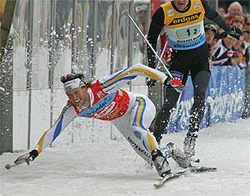
Team Sprint Exchange Zone
Size L = 45 m, W as you can spare
Entrance
Exit
Team space
  Position
  Limitation of Personnel
Control of Exchange

Slide 36
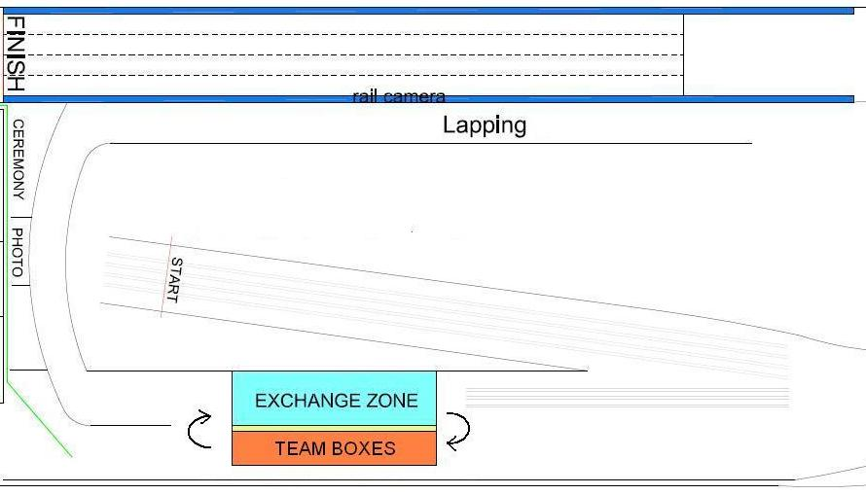
Example 1

Slide 37
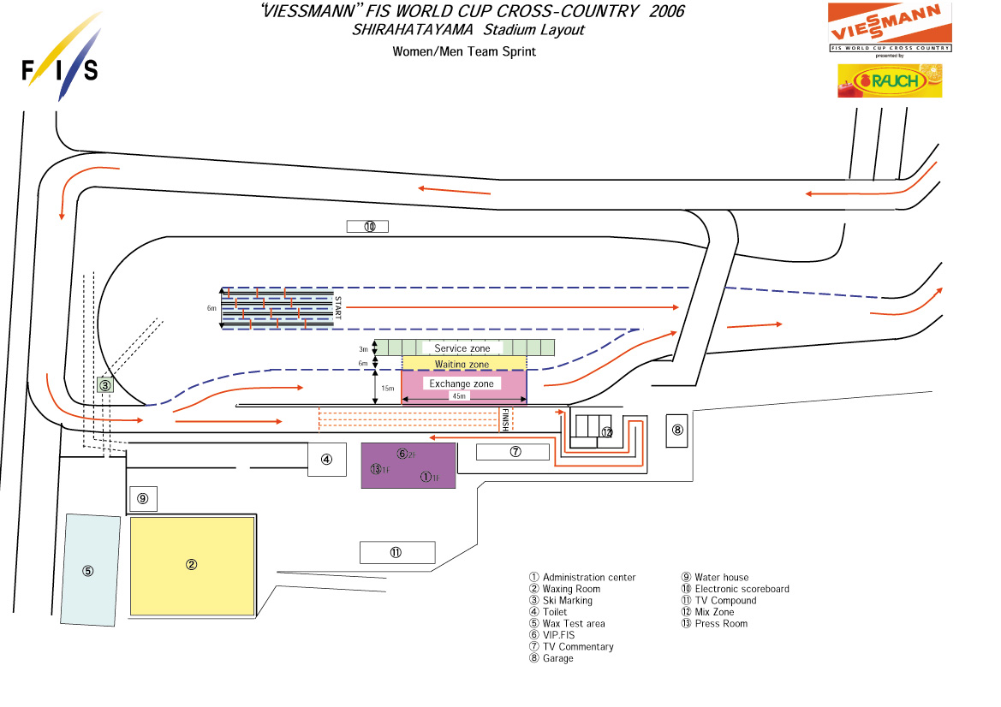
Example 2

Slide 38

Questions

