Slide 1
FIS Points System
Jakub Vodrazka (CZE)

Slide 2
    Why points?
    How a competitor obtains points?
    FIS Code
    Race points calculation
    Race penalty calculation
    FIS points lists
    What’s new in 2011?
    TD duty procedure related to FIS pts

Slide 3
Purpose of FIS Points System
  Establishing Qualification for OWG/WSC/WC
  Grouping
  Start list Composition
Kind of General Classification of Athletes
Rules
  ICR 331.2
  Special Rules and Guidelines Published by FIS

Slide 4
Evaluation of Competition
The following competitions will be evaluated for FIS points:
OWG, WSC, JWSC, WC, Continental Cup and FIS competitions.
Conditions
- The Courses must be homologated (ICR article 313). In special
cases (moving the competition to a substitute course) the Technical
Delegate (TD) has to confirm the norms of the course according to
ICR article 312.
Announcement of the competition in the FIS Calendar.
Strict observance of the International Competition Rules (ICR).
At least five competitors have to be classified.
FIS Code (start, result lists).

Slide 5
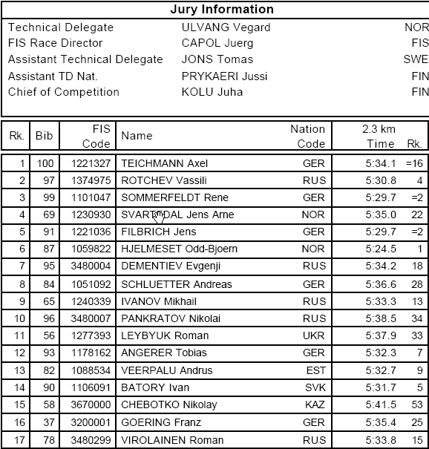
FIS Code
For participation at OWG, WSC, JWSC, WC, Continental Cup and FIS competitions a personal FIS Code number is required.
Unique Identifier of a competitor for FIS Information System
  Does not change through whole career
Registration by NSA
  Signed Athletes Declaration
  Paid FIS Code 30 CHF / 100 CHF
  Status at www.fisski.com
  Active - Not Active - Retired

Slide 6
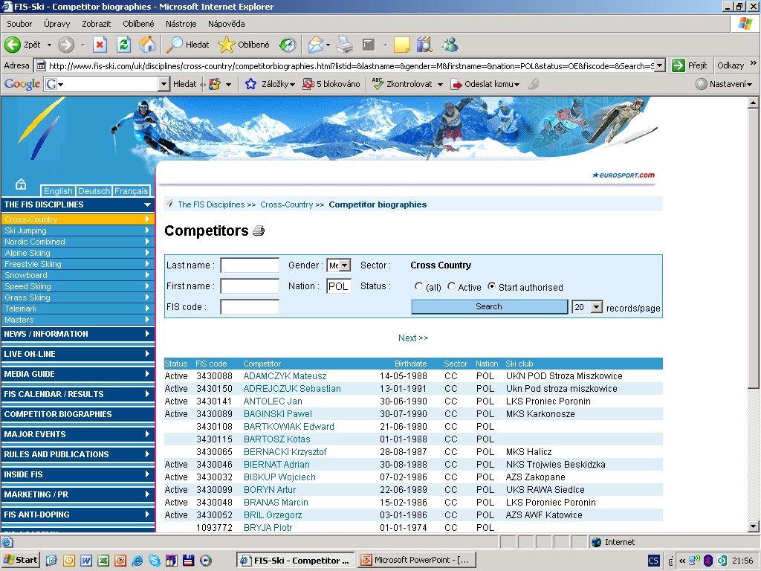

Slide 7
Race Point Calculation
Calculated by computer x double check some data inputs
min. 5 ranked athletes
athletes with FIS Codes (all competition lists!)
correct comp.format
Factor Competition Format
Factor 800 Competitions with interval start
Factor 1200 Sprints and Pursuit (with a break)
Factor 1400 Competitions with Mass start and Skithlon (without a break)

Slide 8
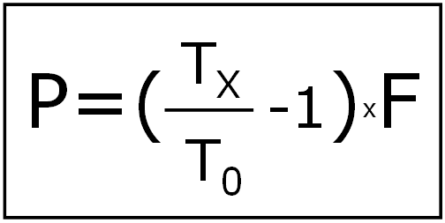
Race Point Formula
P = Race points
T_{x} = Time of competitor X [in seconds]
T₀ = Time of winner [in seconds]
F = Factor
The points shall be rounded down from four thousandths of a point downwards and rounded up from five thousandths of a point upward (e.g. 23.654 = 23.65 or 23.849 = 23.85).

Slide 9
Race Penalty
The importance of a competition is determined by the quality of the competitors participating. This quality affects the calculation of the race penalty.
Race points + Race penalty = FIS points
The race points gained in the competition and calculated according to the formula, plus the calculated race penalty will give each classified competitor the FIS points of the competition.
Round Race Penalty to 2 decimal points
  20,113 → 20,11
  20,115 → 20,12

Slide 10
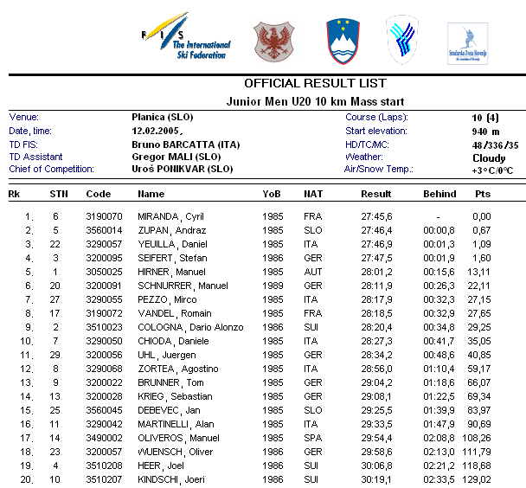
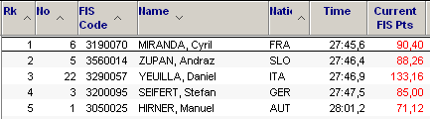
Step 1:
Take Top 5 ranked athletes
and look for their FIS Points in
the current FIS Pts List.
Step 2:
Take three best values
= the lowest points.
1
Step 3:
Make the sum and divide it
by 3,75.
This is Race Penalty.
2
3
71,12 + 88,26 + 85,00 = 244,38
244,38 / 3,75 = 65,168 → 65,17

Slide 11
Calculation
if there are less then three athletes within top 5 who are not listed in FIS Pts List (no FIS points)
or
if athletes within top 5 has more than the bellow stated maximum FIS Points we use these values for calculation:
  176 for Interval start
  264 for Sprints and Pursuit
  308 for Mass start comp. and Skiathlon

Slide 12
Minimum / Maximum Race Penalty
If the calculated penalty is higher than the minimum penalty, the calculated penalty will be applied to the race.
If the calculated penalty is less than the minimum penalty, the
minimum penalty will be applied to the race.
For the Junior World Ski Championships a maximum penalty of 35 points will be calculated (Ladies and Men).
For the U23 World Championships a maximum penalty of 25 points will be calculated (Ladies and Men).

Slide 13
 | Minimum Race Penalty | “Maximum” Race Penalty
OWG | 0 | 0
WSC | 0 | 0
WC | 0 | 0
U23WSC | 25 →0 | 25
JWSC | 35 | 35
COC, FIS | 15
FIS Junior | 35

Slide 14
News 2010 - 2011
Multistage events (2 competitions and more)
Only the real race time of the competitors will be accepted for FIS point calculation. In case of a pursuit start, the FIS points will be calculated on fastest time on this competition for those specific kilometres.
The result list must be published day by day and competition by competition using the correct factor.
The overall result on a Multistage event will not be calculated for FIS point list.
Check the validity of FIS point list!

Slide 15
FIS points lists
Distance (longer than Sprint)
A competitor's points will be the average of his or her best five results over the period of the last twelve months.
Sprint
A competitor's points will be the average of his or her best five results over the period of the last twelve months.
If the competitor has less than 5 valid results the average will be adjusted according to the following:
ø of 4 results x 1.1 = FIS points
ø of 3 results x 1.2 = FIS points
ø of 2 results x 1.3 = FIS points
only 1 result x 1.4 = FIS points

Slide 16
http://www.fis-ski.com
Valid FIS Points List
  5 pairs of lists (distance/sprint) per year
  Always just one valid pair of lists

Slide 17
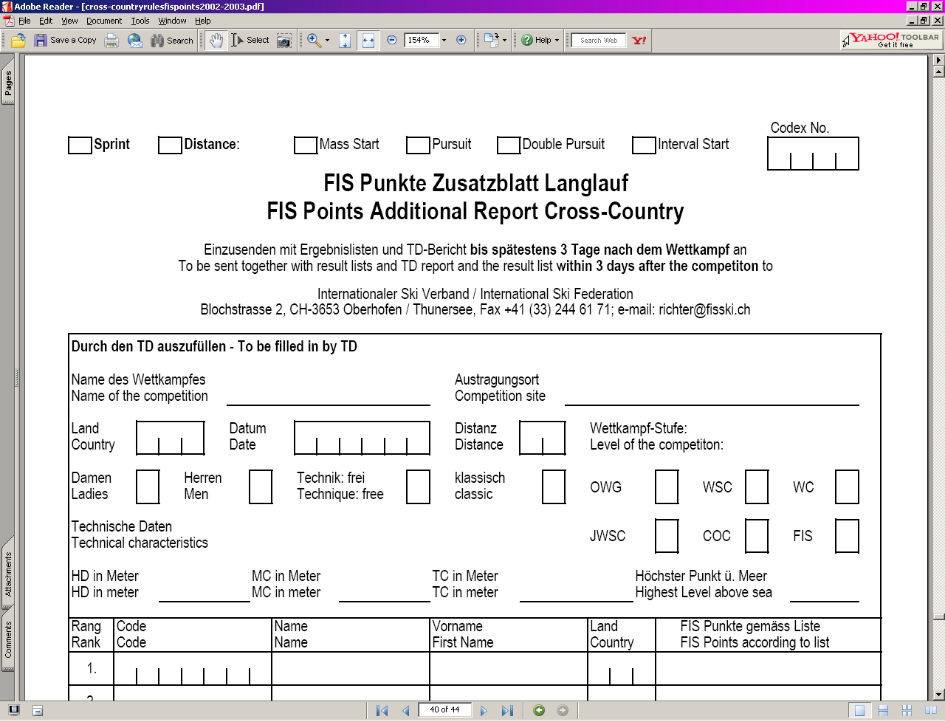
Fis Points Additional Report

Slide 18
Make sure that:
  Timekeepers use correct factor (according to race format)
  Valid FIS points list is used
  Multi day Competition & New FIS list - use the one that is valid on the day of Team Captains Meeting = draw of the start list!
  FIS Codes are on Result list
  Xml file to FIS !!! ASAP (immediatellly) …
Prepare Additional report for race penalty calculations
Check publishing of the results on FIS web!

Slide 19
Exercise ☺

Slide 20
1
T₀ = 27 ^{x} 60 + 45,6 = 1665,6 sec
C.Miranda (FRA)
2
T_{SS} = 27 ^{x} 60 + 47,5 = 1667,5 sec
S.Seifert (GER)
3
F = 1400
Mass start competition
4
P_{SS}= ((T_{SS} / T₀) – 1) x 1400
= 1,5970220941402497598
= 1,60

Slide 21
Questions?
Coffee break …

Slide 22
FIS Popular Races
Jakub Vodrazka (CZE)

Slide 23
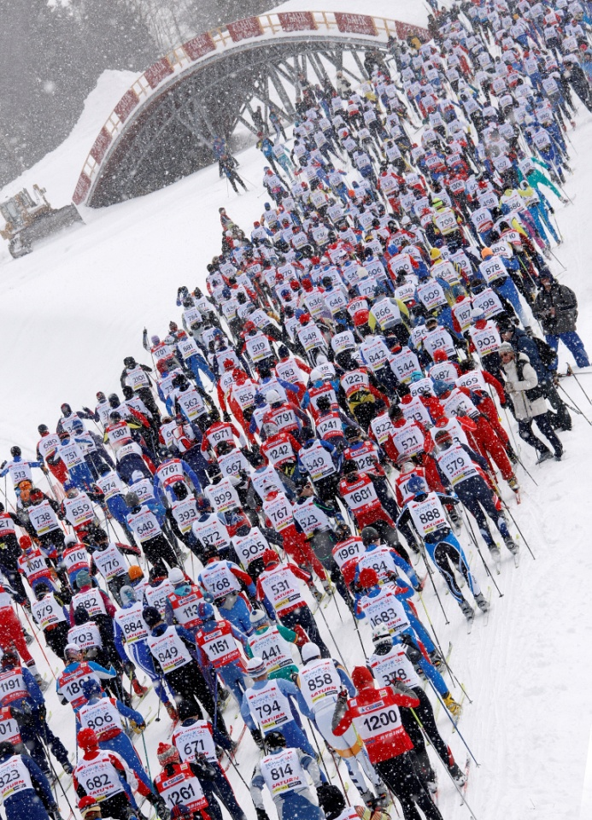
Agenda
Definition of Popular Racing
The Role of the Popular TD
FIS Guide for TDs and Organisers of Popular Long Distance Races
(general info)
The Start
The Course
The Finish Area
Medical, Evacuation and Communications

Slide 24

Definition of Popular Racing
Popular Cross-Country competitions are competitions open to all cross-country competitors, licensed or non-licensed.
There is no limitation on the competition distance or format of popular cross-country competitions and the main race may be supported by a series of shorter races to create a varied programme with opportunities for skiers of all ages and standards and of both genders to compete.
The main races in the programme should be in mass start format and of a minimum distance of 40 km for men and 30 km for ladies; supporting races may be of such distance and format as the organisers of the competition may decide to meet local demand and to attract as many skiers as possible into the competitions.

Slide 25
The Role of Popular TD
The Popular TD must already be experienced in ‘normal’ races and have a knowledge of ICR.
But the TD in a popular race has a largely different role from the TD in a WC or COC race.
The primary responsibility of the TD is the safety of the competitors.

Slide 26
The Role of Popular TD
in addition to his normal duties the TD must concentrate on:
course inspection and eliminating danger spots
checking the medical and safety aspects, liaison with the medical staff, communications and evacuation
checking arrangements for feeding stations
checking course controls including time limits
checking availability of toilets at start
checking baggage and skis collection

Slide 27
The Role of Popular TD
It is also important to emphasize that in many cases the final layout of the start and finish areas will only be put in place the evening before the race and it is difficult in those circumstances to make immediate changes.
The TD must then put forward proposals for the future.
The specific Guidelines for popular cross-country races are contained in ICR Section G (380 – 389).

Slide 28
http://www.fis-ski.com
FIS Guide for TDs and Organisers of Popular Long Distance Races
does not have the force of ICR, but fleshes out the rules.
Suggestions for amendment/addition/improvement.

Slide 29
Start
Suitability for coping with projected number of starters
Sufficient number of tracks (Classical)
Bottlenecks after the start and ways of combating them
  different types of start
  Mass
  Wave
  ‘Le Mans’
Control of entry into start area. Separation of men and ladies? Elite group
Ropes/barriers/manual/electronic and verification of start mechanisms.

Slide 30
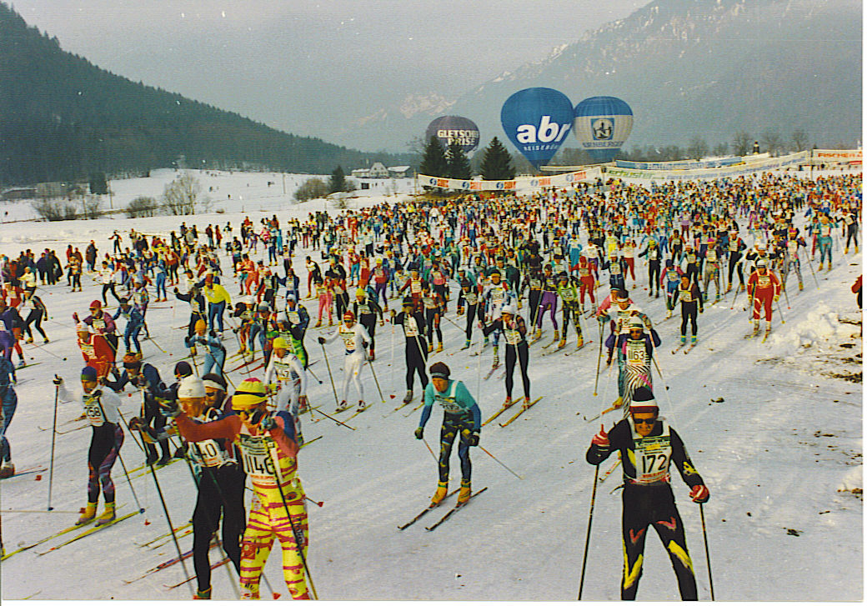
The Start (Mass Start)
Sufficient number of tracks (Classical)

Slide 31
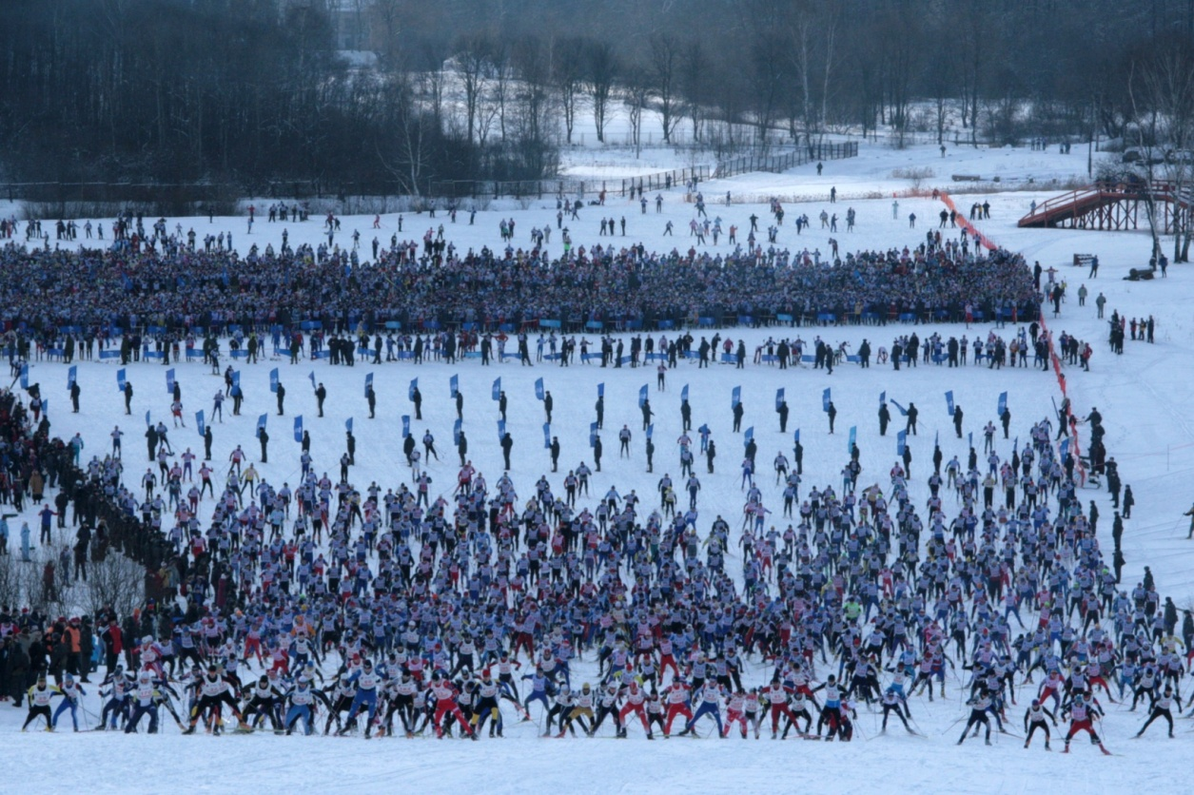
The Start (Wave Start)
Suitability for coping with projected number of starters

Slide 32
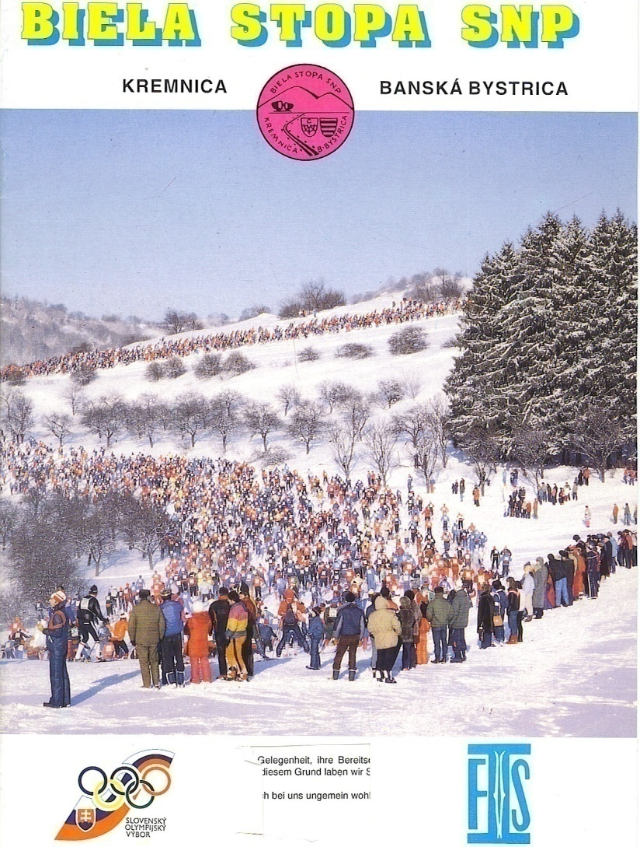
The Start (avoiding bottlenecks)
Bottlenecks after the start and ways of combating them :
different types of start
- mass,
wave,
‘Le Mans’

Slide 33
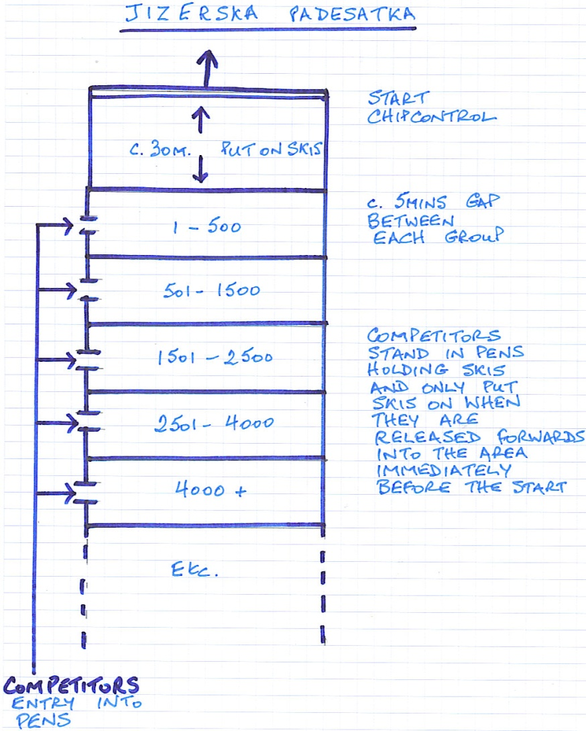
‘Le Mans’ Start
avoiding bottlenecks

Slide 34
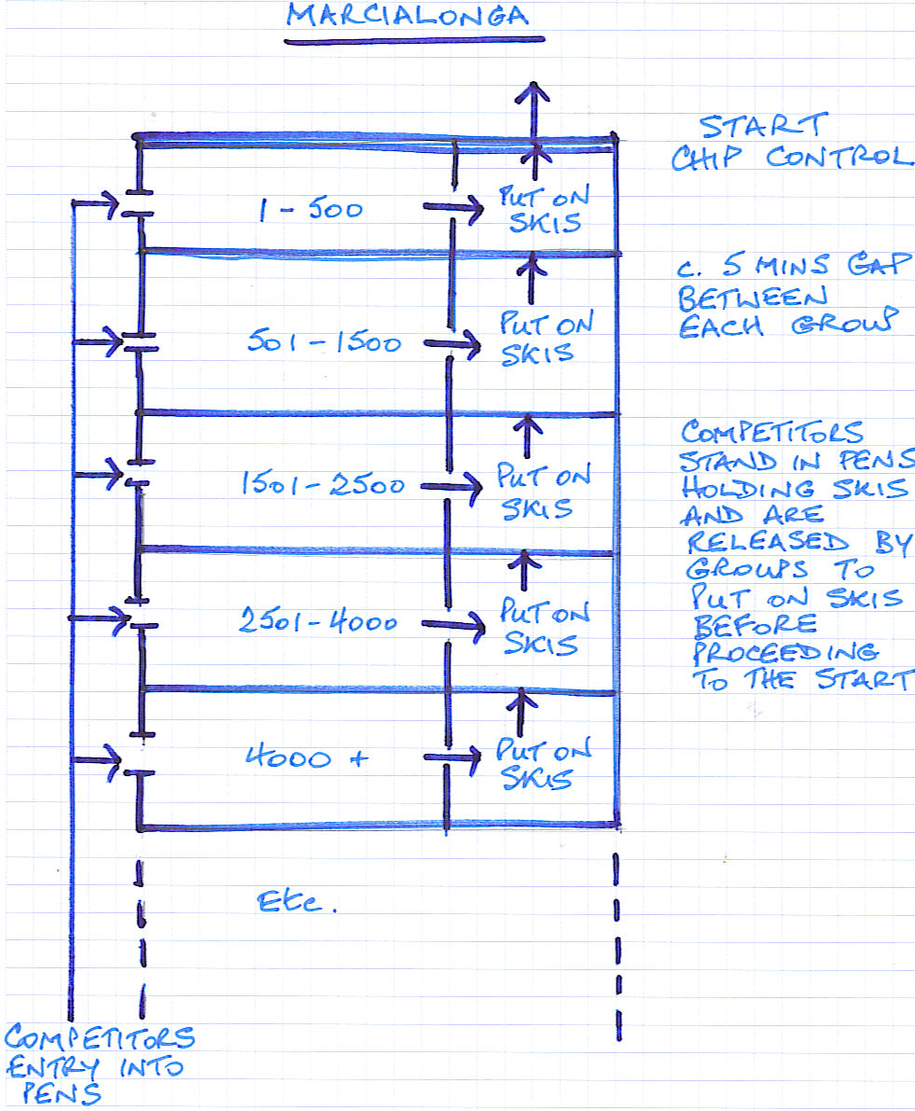
‘Le Mans’ Start
avoiding Bottlenecks

Slide 35
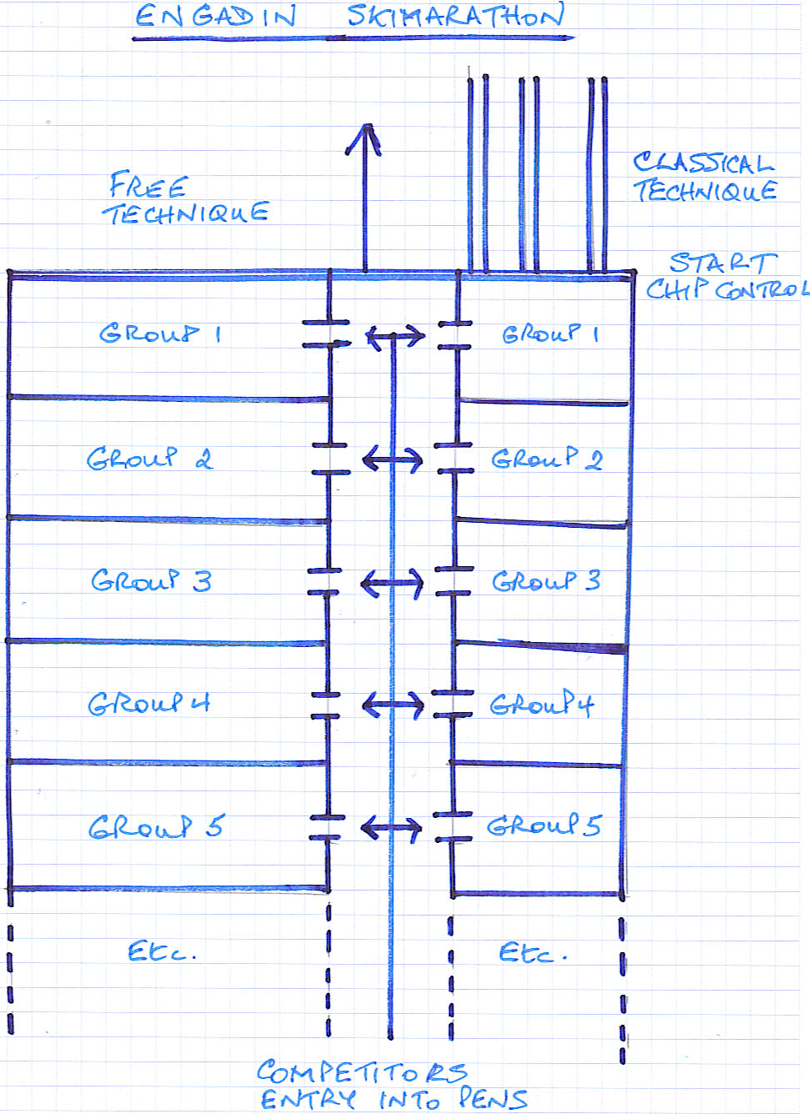
Separating Classical and
Free techniques

Slide 36
The Course (incl grooming, Classic and Free Technique together)
An inspection on skies of at least the majority of the course, including all potential accident areas, is essential.
The Assistant TD can be brought in to ski part of the course.
In a race of over 50 km, this will be time-consuming, and must be built into the TD’s program! (think for both days in advance)
The best inspection is on ski but snowmobile can be used on occasion and on the flatter parts of the course.

Slide 37
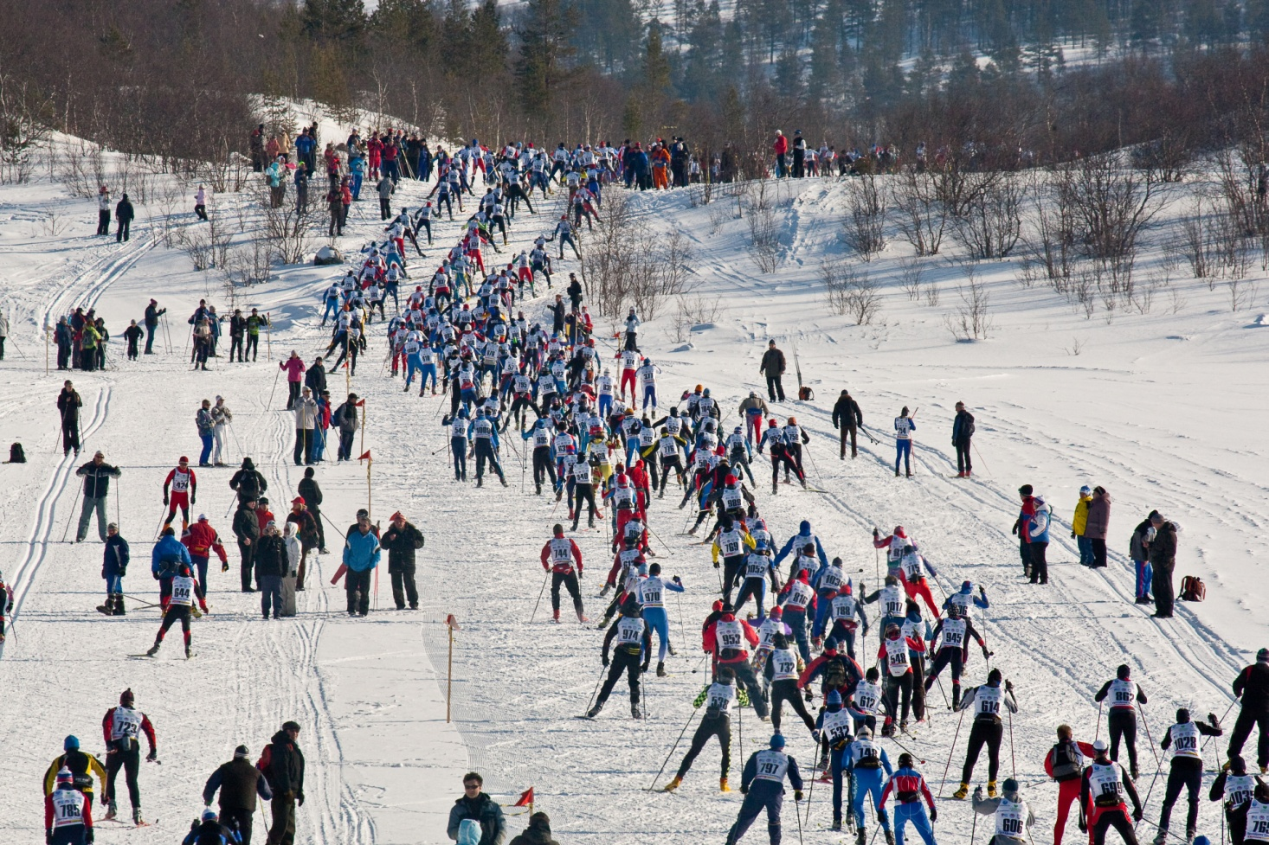
The Course
Particular points to look for TD
will include:
Snow cover and means
to remedy deficient areas
Marking of the course,
including km markers
Potential accident areas and means
taken to diminish the possibility
and consequences of an accident
Siting of feeding and medical points
Track preparation (adequate for 1000 - 10000 participants)

Slide 38
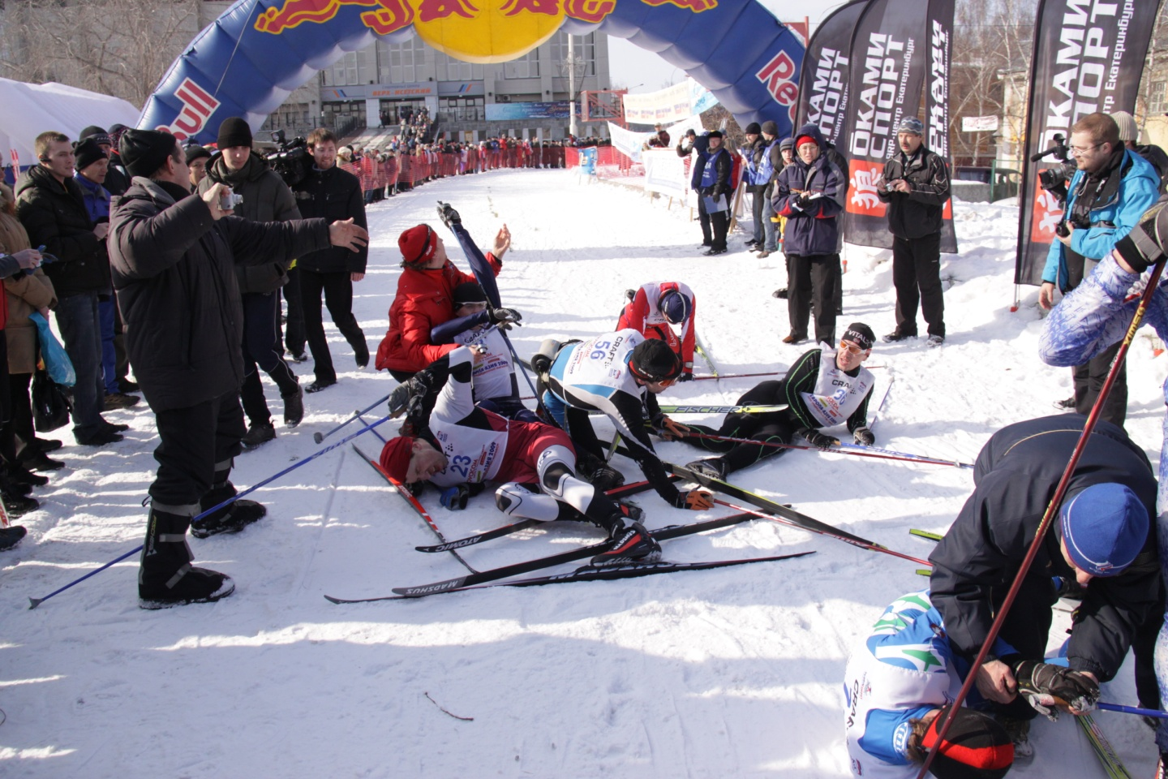
The Finish Area
Sufficient space for number of competitors in the finish area, with a minimum of 3 lanes over the final 100 m for the longer race finish and dedicated lanes for a shorter race if it is finishing at the same time
Ways of avoiding conflict with short and long races finishing together (in City Centre finish), including
  separate finish corridors
  holding areas
Photo Finish and/or video
must be set up on finish line

Slide 39
The Finish Area
Good flow of competitors at end of race to and through necessary facilities is essential:
  Medical
  Feeding
  Safeguarding of skis
  Changing and showers
  Medals
  Buses back to their accommodation
  Signing in several languages is important

Slide 40
Medical/Safety for Popular Races
Types of medical issues
  Cold weather (hypothermia, frostbite, airway injury)
  Injury and illness
Preparation for the competition
  Personnel and equipment
  Selecting course medical locations
Incident response
  Communication
  Protocol
  Evacuation
Management of catastrophic incidents
Application of FIS rules, reporting to FIS, and education of competitors

Slide 41
Medical, Evacuation and Communications
Go through safety (medical and evacuation) plan with Chief Medical Officer.
(Must be coordinated with communications plan. Minimize time before sick or injured can receive medical assistance).
Qualified personnel at medical stations?
Frequency and sitting of medical posts around the course (and in Finish Area).
Evacuation procedures. Actions to be taken in the event of death.

Slide 42
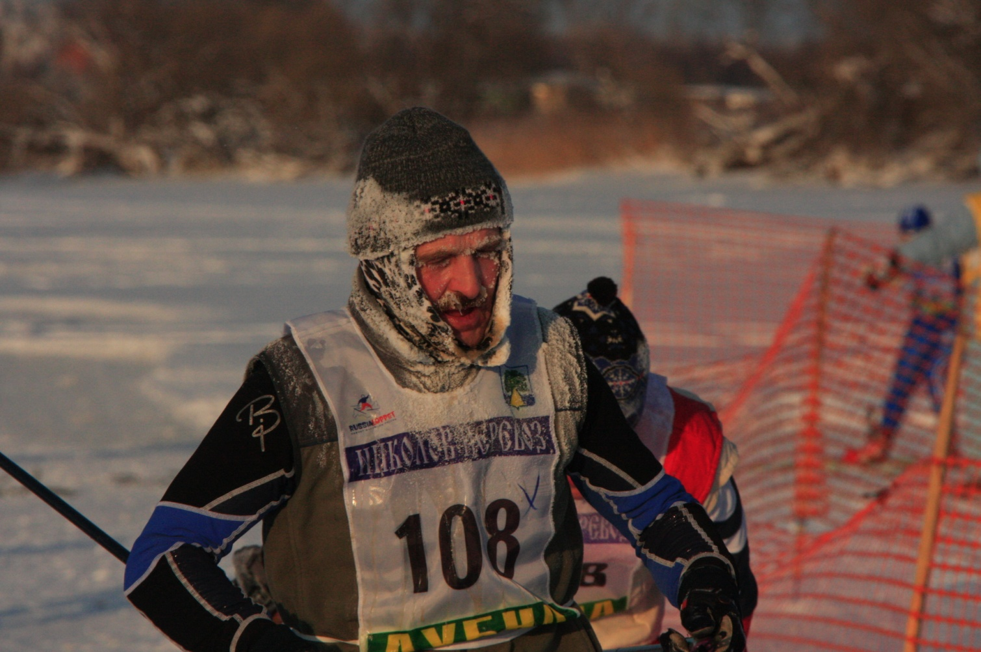
Management of Cold Weather Issues
FIS temperature limit for popular racing is
-25 deg. Celsius
How to manage the cold weather rule:
  Difficulty of evacuation
  Unsafe to leave competitors
  inactive at the start
  Base decisions on forecast 24 hrs in advance
  Check differences in temperature on course
  Use local experience to judge likely temperature rises during day
  Information to competitors on clothing and precautions
  Control checks for hypothermia and frostbite
  Include information in TD Report

Slide 44
CHECKLIST FOR TDs FOR POPULAR RACES
BEFORE THE COMPETITION - GENERAL
Make contact with the race organising committee on receipt of assignment from FIS 304.3.2
Check race announcements and information for competitors 382.1.1/382.1.2
Check arrangements for Jury and for handling problems and protests 304.3.3
Arrive on site in time to have two clear days before the competition 304.3.1
Check the race organisers insurance policy 212.2
Check arrangements for prizes 219
Check arrangements for Team Captains meetings (FMC) 304.3.3
Delegate specific duties to assistant TD if necessary
Check Medical, Evacuation and Communications Plans
Review cut-off locations and times
Check if FIS points are to be scored
Ascertain weather forecasts for race day

Slide 45
CHECKLIST FOR TDs FOR POPULAR RACES
BEFORE THE COMPETITION - THE COURSE
Ski all or parts of the course 304.3.3
Decide if course is satisfactory with special regard to safety or if changes are necessary304.3.3
Check road crossing arrangements 384.4.3 and 384.4.4
Check course marking 384.5
Check provision of km boards 384.5
Check conditions for officials 320.2
Check arrangements for feeding stations 384.6
Check medical aspects/first aid stations / cold weather 304.3.2 safety 386
Determine grooming plan, with ability to re-groom during the race

Slide 46
CHECKLIST FOR TDs FOR POPULAR RACES
BEFORE THE COMPETITION - THE START
Check start procedures/groupings 381.4.1
Check layout of start area 384.2.1
Check that there are sufficient tracks 384.3.1 / 384.4.4
Check availability of toilets at start 320.3.3
Check loudspeaker information 320.4.4
Other information and signing 320.4.5
Check ski marking arrangements 342
Check medical facilities 386.4.1

Slide 47
CHECKLIST FOR TDs FOR POPULAR RACES
BEFORE THE COMPETITION - THE FINISH
Check layout of finish area 384.3.1
Check timekeeping arrangements 352.1.1
Check finish recording arrangements 320.2.2 /353
Check ski checking arrangements 353.1.7
Check availability of medical facilities 386.4.1
Check availability of refreshments 384.6.1
Check baggage collection and changing arrangements 382.2.1
Protest time 15 mins after publication of the relevant unofficial results

Slide 48
CHECKLIST FOR TDs FOR POPULAR RACES
BEFORE THE COMPETITION – CONTROLS
Advertising controls 385.1.1
Equipment controls 381.7
Doping controls 221.4
Technique controls 385.1.1
Other course controls including time limits and completion of full course 382.2.1
Closing patrol 382.2.1

Slide 49
CHECKLIST FOR TDs FOR POPULAR RACES
DURING THE COMPETITION
Arrive at start 2 hours before competition 304.4.1
Receive report from chief of competition and chief of course 304.4.1
Check temperature on selected parts of the course 304.4.1
Check equipment and commercial markings for elite group 304.4.1
Remain in start area until all starts have been completed, then transfer to finish area 304.4.1
Stay in contact with chief of competition and chief of race, by radio if possible 304.4.1
Supervise all aspects of the race 304.4.1

Slide 50
CHECKLIST FOR TDs FOR POPULAR RACES
AFTER THE COMPETITION
Call Jury meeting and receive reports from members 304.5.1
Receive and consider any protests
Receive and check unofficial results list 304.5.1
Agree expenses with organisers 305.
Submit report to FIS within 3 days 304.5.2

